Slide 1


Gurudwaras
in UAE
About
Sikhism

Slide 2
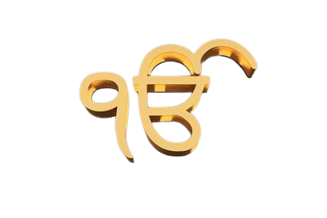
IK ONKAR
There is only one God

